Slide 1

HOME AUTOMATION PROJECT
Robotronics Club

Slide 2

SMART HOME
By-
Anmol Bishnoi
Muskan Yadav
Prachee Mathur

Slide 3
IDEOLOGY
Participants usually create machines that are just proof of concept and only work in small scale models.
They have also create projects that target very specific things that aren’t even problems.
Instead, we planned to actually tackle a real world problem that almost everyone faces every day atleast once.

Slide 4
PROBLEM
Have you ever fealt that while going to bed, that the light switch was too far or maybe you’re sitting very comfortably and you’d like to turn on the heater or fan or turn off the lights.
In that moment you just wished that the lights would somehow turn off magically

Slide 5
EXISTING SOLUTION
Existing solutions include getting smart home appliances, which tend to be pretty expensive. A MI smart LED bulb costs Rs. 800
Apart from that you probably also need a hub like the Google Home Mini which is an additional Rs. 2500
Which again would only work specifically with smart home appliances and you can’t really make things that you already own “smart”.

Slide 6
OUR SOLUTION
Using an Arduino, a Bluetooth module and relays we can easily target turn on and off every single switch individually or collectively.
Additionally, the Arduino can also be used to do pre-planned programs like turning on the lights at 5pm everyday.
The Arduino is attached to a Bluetooth Module and the input is given using an app.
The Arduino gets power from a small 5000mAh battery bank.

Slide 7
RELAY
An electrical relay is a device which switches on/off if a small dc signal is given to it which can easily be done by an Arduino microcontroller.
These relays are very inexpensive and multiple can be used to achieve the desired level of home automation.
We bought relays for Rs. 76.4 each and every individual relay can be used to control one device
The relays are connected to the Neutral wire behind a socket and act as an additional switch that turns on everytime we switch it on using the Arduino.
Relays have existed since a very long time and are the exact same thing that make the sound when you turn on indicators in older cars.

Slide 8
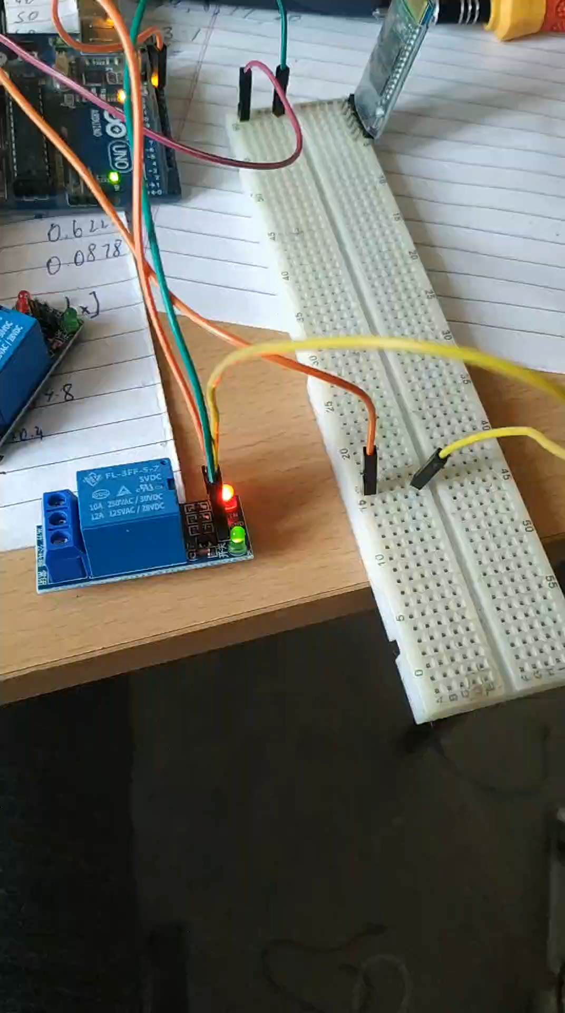
TESTING OUR RELAYS

Slide 9

ADDITIONAL PROBLEM TACKLED
Carrying keys, locking your room when going out is a major major hassle.
Similarly, when a friend comes to your hostel room, you need to get up from your chair to open the door for them.

Slide 10
SMART LOCK FUNCTIONALITY
This time we use a simple medium strength dc servo again controlled by the Bluetooth connected Arduino.
The servo is useful when you need precise movements in a particular direction.
The servo is used to move the latch up and down on the door and this can be done using your phone, whether your’re inside or outside your room.
Thus, becoming a smart lock of sorts that can be controlled by your phone.
Commercial Keyless Fingerprint locks start from Rs. 2000 while our servo just cost us Rs. 407.

Slide 11
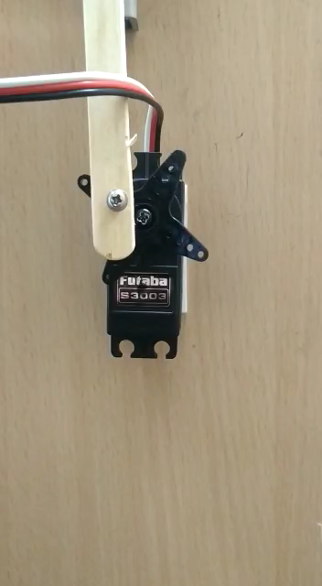
VIDEO OF SMART LOCK FUNCTION IN ACTION
The servo connected to Arduino rotates anticlockwise
It pulls the wooden stick downwards
Which in turn is hinged and attached to the latch
Thereby, unlocking the door

Slide 12
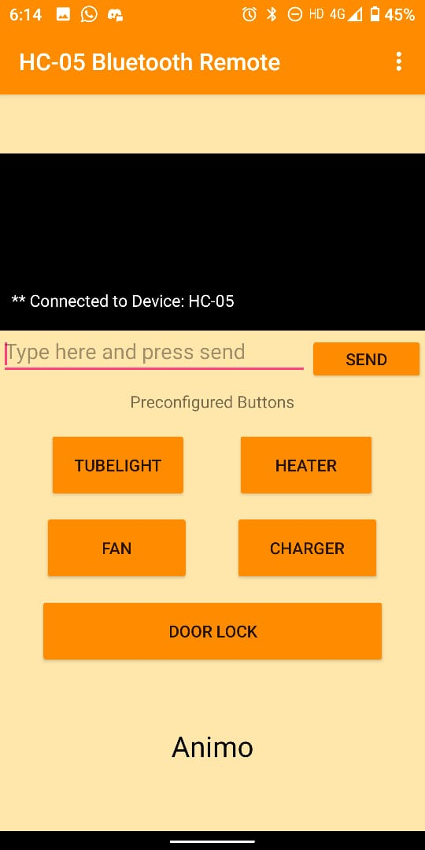
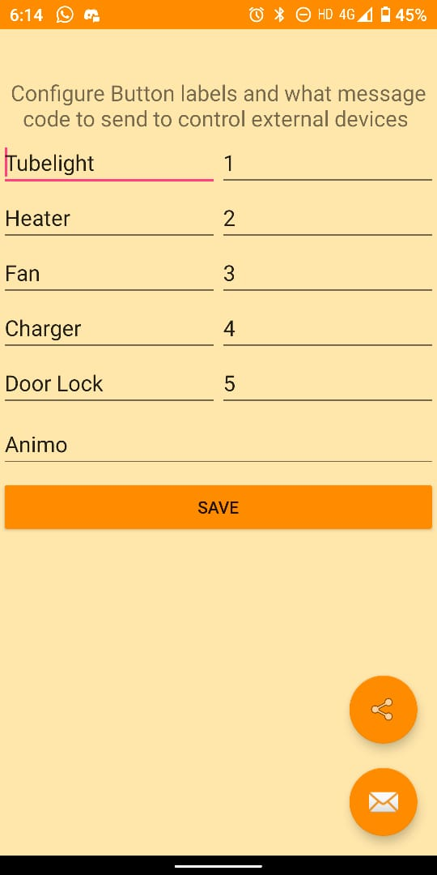
SCREENSHOTS FROM THE APP THAT CONTROLS ALL OF THIS
The UI (App downloaded from Play Store)
The commands it sends to the Arduino

Slide 13
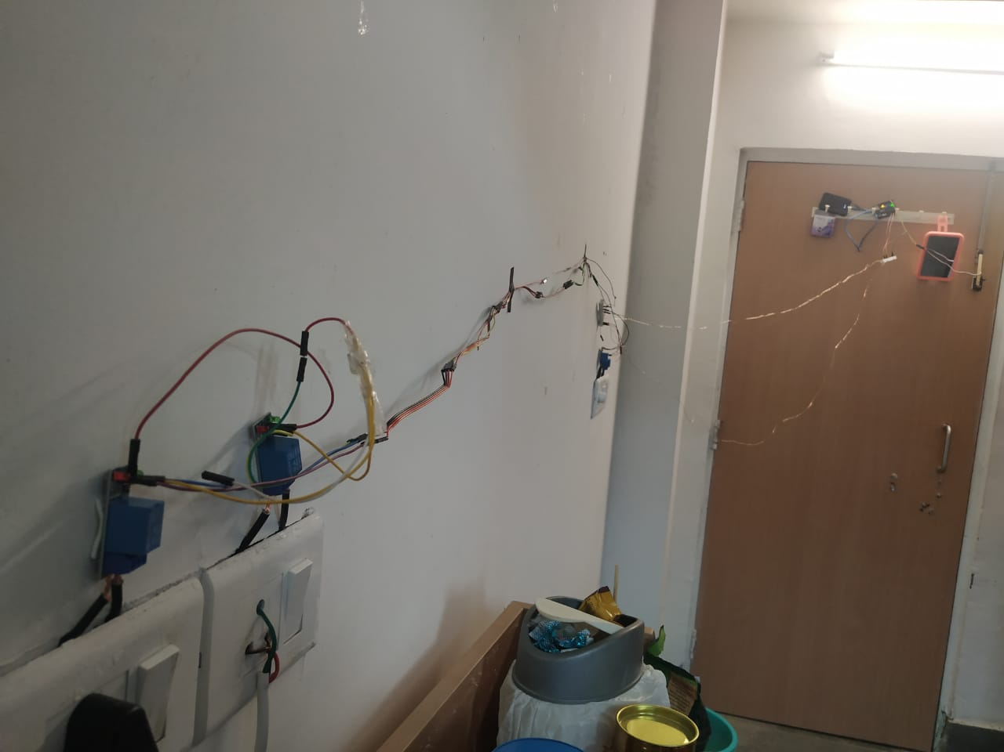
PICTURES OF THE FINAL ROOM
Although slightly messy right now, this can be tidied up later

Slide 14
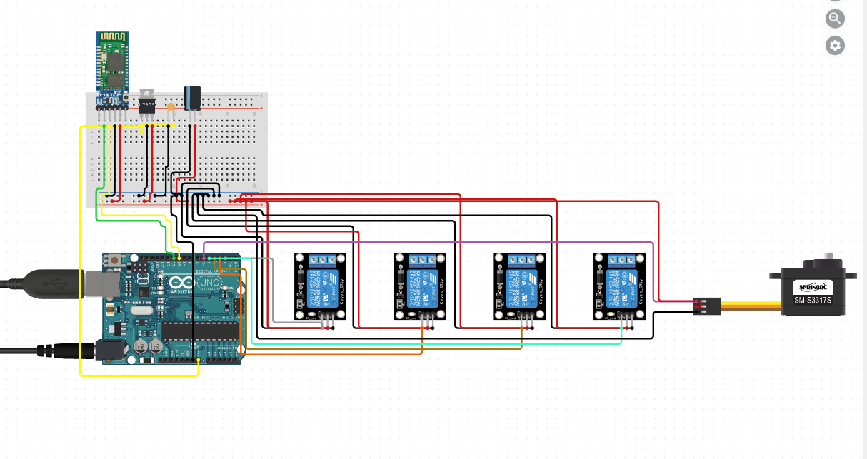
BASIC CIRCUIT DIAGRAM

Slide 15
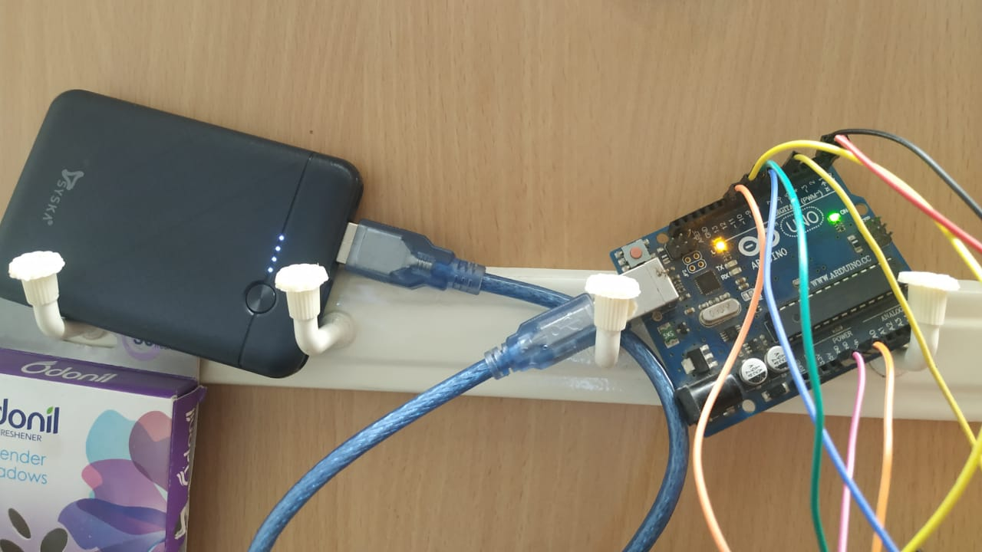
ARDUINO AND BATTERY BANK SIT ON DOOR SAFELY

Slide 16
TOTAL EXPENDITURE VS MONEY SAVED
We spent
Commercial Alternative
Component | Price
Arduino (Non-Generic) | Rs. 384
Bluetooth Module | Rs. 425
5 Relays | Rs. 382
5000 mAh Battery Bank | Rs. 379
Medium Servo | Rs. 407
Wires and Additional Expenses | Rs. 100
Total | Rs. 2077
Component | Price
Google Home Mini | Rs. 2490
Smart Lock | Rs. 1999
Alexa enabled smart switches (4) | Rs. 645 x 4 = Rs. 2580
MI single color Smart LED Bulb | Rs. 799
Additional Electrician Expenses | Rs. 1000
Total | Rs. 8868

Slide 17
CONCLUSION
We created a project a super functional project demonstrating our Arduino skills.
The product is actually very useful and looking at it, you’ll probably want one yourself
It incorporated the use of fairly cheaply available relays and servos to achieve a simple yet highly helpful end product.
We saved around Rs. 7000 had we aimed to do the same using commercially available alternatives.

Slide 18
Github link for code – https://github.com/ANIMO-07/smart-home/blob/main/smortie.ino

